Slide 1
BLACK BOX TESTING

Slide 2
Test case design
During test planning, have to design a set of test cases that will detect defects present
Some criteria needed to guide test case selection
Two approaches to design test cases
functional or black box
structural or white box
Both are complimentary; we discuss a few approaches/criteria for both

Slide 3
Black Box testing
Software tested to be treated as a black box
Specification for the black box is given
The expected behavior of the system is used to design test cases
Test cases are determined solely from specification.
Internal structure of code not used for test case design

Slide 4
Equivalence Class partitioning
Divide the input space into equivalent classes
If the software works for a test case from a class the it is likely to work for all
Can reduce the set of test cases if such equivalent classes can be identified
Approximate it by identifying classes for which different behavior is specified

Slide 5
Equivalence Class Examples
In a computer store, the computer item can have a quantity
between 500 to 1500. What are the equivalence classes?
Answer: Valid class: 500 <= QTY <= +1500 Invalid class: QTY > +1500 Invalid class: QTY < 500

Slide 6
Equivalence Class Examples
Account code can be 500 to 1000 or 0 to 499 or 2000 (the field type is integer). What are the equivalence classes?
Answer:
Valid class: 0 <= account <= 499
Valid class: 500 <= account <= 1000
Valid class: 2000 <= account <= 2000
Invalid class: account < 0
Invalid class: 1000 < account < 2000
Invalid class: account > 2000

Slide 7
For a function that computes the square root of the integer values in the range of 0 and 5000, determine
i) the equivalence classes
ii) black box test suite
iii) boundary value test suite

Slide 8
Equivalence class partitioning…
Rationale: specification requires same behavior for elements in a class
Software likely to be constructed such that it either fails for all or for none.
E.g. if a function was not designed for negative numbers then it will fail for all the negative numbers
For robustness, should form equivalent classes for invalid inputs also

Slide 9
Equivalent class partitioning..
Every condition specified as input is an equivalent class
Define invalid equivalent classes also
E.g. range 0< value<Max specified
one range is the valid class
input < 0 is an invalid class
input > max is an invalid class
Whenever that entire range may not be treated uniformly - split into classes

Slide 10
Example
Consider a program that takes 2 inputs – a string s and an integer n
Program determines n most frequent characters
Tester believes that programmer may deal with diff types of chars separately
Describe a valid and invalid equivalence classes

Slide 11
Example..
Input | Valid Eq Class | Invalid Eq class
S | 1: Contains numbers 2: Lower case letters 3: upper case letters 4: special chars 5: str len between 0-N(max) | 1: non-ascii char 2: str len > N
N | 6: Int in valid range | 3: Int out of range

Slide 12
Example…
Test cases (i.e. s , n) with first method
s : str of len < N with lower case, upper case, numbers, and special chars, and n=5
Plus test cases for each of the invalid eq classes
Total test cases: 1 valid+3 invalid= 4 total
With the second approach
A separate str for each type of char (i.e. a str of numbers, one of lower case, …) + invalid cases
Total test cases will be 6 + 3 = 9

Slide 13
Boundary value analysis
Programs often fail on special values
These values often lie on boundary of equivalence classes
Test cases that have boundary values have high yield
These are also called extreme cases
A BV test case is a set of input data that lies on the edge of a eq class of input/output

Slide 14
Boundary value analysis (cont)...
For each equivalence class
choose values on the edges of the class
choose values just outside the edges
E.g. if 0 <= x <= 1.0
0.0 , 1.0 are edges inside
-0.1,1.1 are just outside

Slide 15
Boundary Value Analysis
In BVA we determine the value of vars that should be used
If input is a defined range, then there are 6 boundary values plus 1 normal value (tot: 7)
If multiple inputs, how to combine them into test cases; two strategies possible
Try all possible combination of BV of diff variables, with n vars this will have 7^{n} test cases!
Select BV for one var; have other vars at normal values + 1 of all normal values
Min
Max

Slide 16
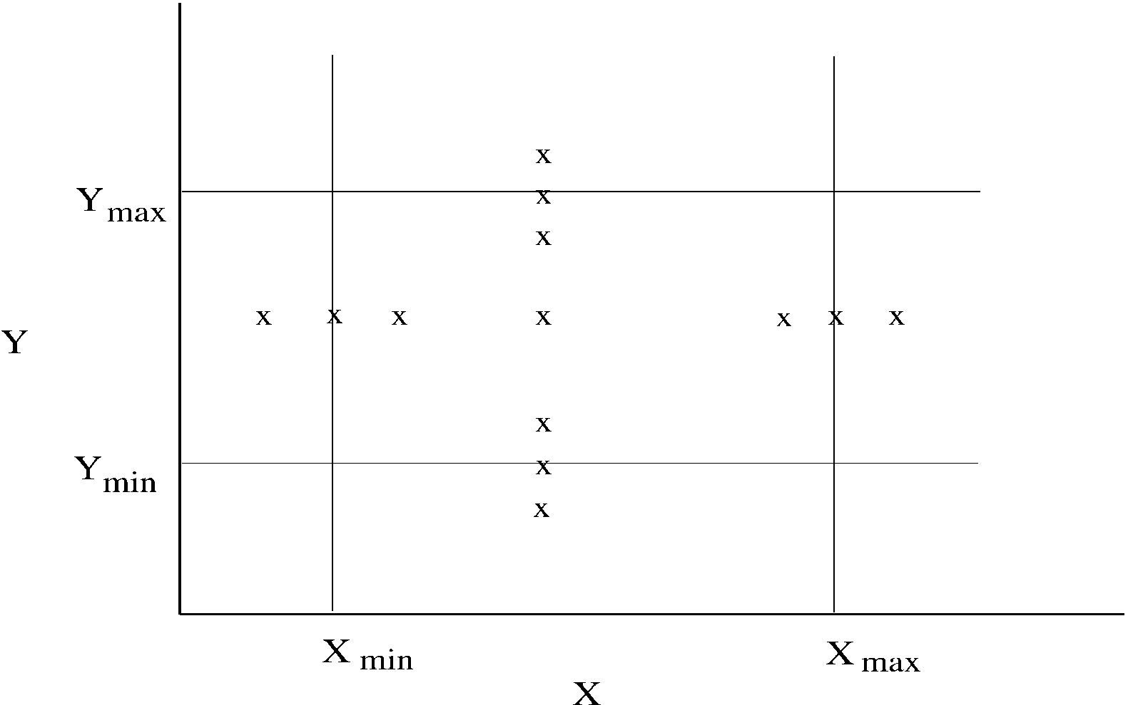
BVA.. (test cases for two vars – x and y)

